Slide 1
How Do We Sequence Antibiotics?

Slide 2
Professor : dr.reza rezazadegan presenters : arsham salari & amir Hossein mohammadipour
04/08/01 bioinformatics

Slide 3
TOPICS
    # The Discovery of Antibiotics
    # How Do Bacteria Make Antibiotics?
    # Dodging the Central Dogma of Molecular Biology
    # Sequencing Antibiotics By Shattering Them Into Pieces
    # Algorithms

Slide 4

What is an antibiotics ?

Slide 5
The Discovery of Antibiotics

Slide 6
In August 1928, before leaving for vacation, Scottish microbiologist Alexander Fleming stacked his cultures of infection-causing Staphylococcus bacteria on a laboratory bench. When he returned to work a few weeks later, Fleming noticed that one culture had been contaminated with Penicillium fungus, and that the colony of Staphylococcus surrounding it had been destroyed! Fleming named the bacteria-killing substance penicillin, and he suggested that it could be used to treat bacterial infections in humans.
When Fleming published his discovery in 1929, his article had little immediate impact. Subsequent experiments struggled to isolate the antibiotic agent (i.e., the compound that actually killed bacteria) from the fungus. As a result, Fleming eventually concluded that penicillin could not be practically applied to treat bacterial infections and abandoned his antibiotics research.

Slide 7
Also in 1942, Russian biologists Georgy Gause and Maria Brazhnikova noticed that the Bacillus brevis bacterium killed the pathogenic bacterium Staphylococcus aureus. In contrast to Fleming’s efforts with penicillin, they successfully isolated the antibiotic compound from Bacillus brevis and named it Gramicidin Soviet. Within a year, this antibiotic was distributed to Soviet military hospitals.
Meanwhile, American scientists were scouring various food markets for rotten groceries and finally found a moldy cantaloupe in Illinois with a high concentration of penicillin. This mundane discovery allowed the United States to produce 2 million doses of penicillin in time for the Allied invasion of Normandy in 1944, thus saving thousands of wounded soldiers’ lives.

Slide 8
peptides
Gause continued his research into Gramicidin Soviet after World War II but failed to elucidate its chemical structure. Taking the torch from Gause, English biochemist Richard Synge studied Gramicidin Soviet and a wide array of other antibiotics produced by Bacillus brevis. A few years after World War II ended, he demonstrated that they represent short amino acid sequences (mini-proteins) called peptides.

Slide 9
MRSA
Methicillin-resistant Staphylococcus aureus
The mass-production of antibiotics initiated an evolutionary arms race between pharmaceutical companies and pathogenic bacteria. The former worked to develop new antibiotic drugs, while the latter acquired resistance against these drugs. Although modern medicine won every battle for six decades, the last ten years have witnessed an alarming rise in antibiotic-resistant bacterial infections that cannot be treated even by the most powerful antibiotics. In particular, the Staphylococcus aureus bacterium that Gause had studied in 1942 mutated into a resistant strain known as Methicillin-resistant Staphylococcus aureus (MRSA). MRSA is now the leading cause of death from infections in hospitals; its death rate has even passed that of AIDS in the United States.
With the rise of MRSA at hand, developing new antibiotics represents a central challenge to modern medicine. A difficult problem in antibiotics research is that of sequencing newly discovered antibiotics, or determining the order of amino acids making up the antibiotic peptide.

Slide 10
How Do Bacteria Make Antibiotics?

Slide 11
How peptides are encoded by the genome
Tyrocidine B1
Let’s begin by considering Tyrocidine B1, one of many antibiotics produced by Bacillus brevis. Tyrocidine B1 is defined by the 10 amino acid-long sequence shown below (using both the one-letter and three-letter notations for amino acids). Our goal in this section is to figure out how Bacillus brevis could have made this antibiotic.
Val-Lys-Leu-Phe-Pro-Trp-Phe-Asn-Gln-Tyr
V K L F P W F N Q Y

Slide 12
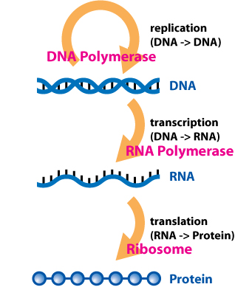
Central Dogma of Molecular Biology
The Central Dogma of Molecular Biology states that “DNA makes RNA makes protein.” According to the Central Dogma, a gene from a genome is first transcribed into a strand of RNA composed of four ribonucleotides: adenine, guanine, cytosine, and uracil. A strand of RNA can be represented as an RNA string, formed over the four-letter alphabet {A, C, G, U}.
Then, the RNA transcript is translated into an amino acid sequence of a protein.

Slide 13
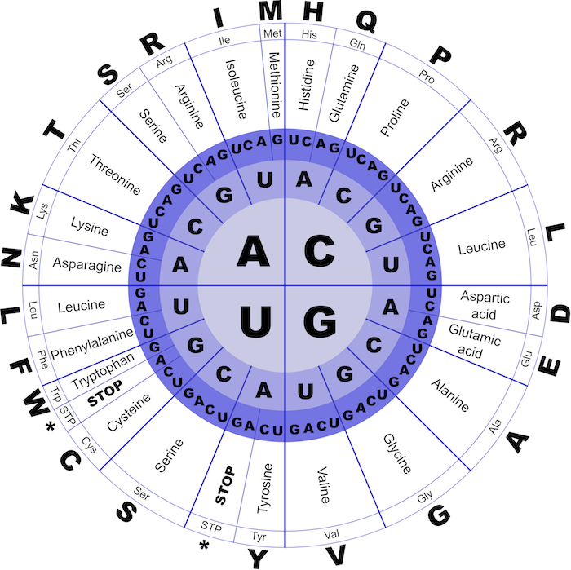
Much like replication, the chemical machinery underlying transcription and translation is fascinating, but from a computational perspective, both processes are straightforward. Transcription simply transforms a DNA string into an RNA string by replacing all occurrences of T with U. The resulting strand of RNA is translated into an amino acid sequence as follows. During translation, the RNA strand is partitioned into non-overlapping 3-mers called codons. Then, each codon is converted into one of 20 amino acids via the genetic code; the resulting sequence can be represented as an amino acid string formed over a 20-letter alphabet. As illustrated in the figure below, each of the 64 RNA codons encodes its own amino acid (some codons encode the same amino acid), with the exception of three stop codons that do not translate into amino acids and serve to halt translation.
For example, the DNA string TATACGAAA transcribes into the RNA string UAUACGAAA, which in turn translates into the amino acid string Y-T-K.

Slide 14
Question !!!
How many DNA strings of length 30 transcribe and translate into Tyrocidine B1 ? (Don't include the stop codon.)
V(4), K(2), L(6), F(2), P(4), W(1), F(2), N(2), Q(2), Y(2)
So -> 4*2*6*2*4*1*2*2*2*2 = 6144

Slide 15
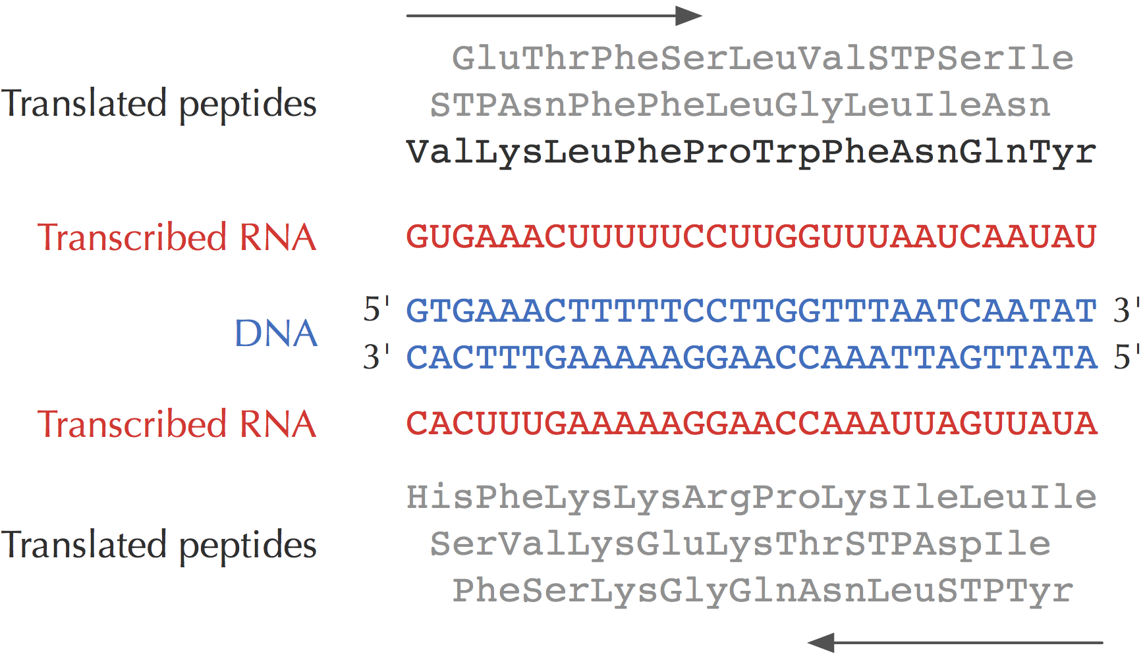
Where is Tyrocidine encoded in the Bacillus brevis genome?
reading frames
Thousands of different DNA 30-mers could code for Tyrocidine B1, and we would like to know which one appears in the Bacillus brevis genome. There are three different ways to divide a DNA string into codons for translation, one starting at each of the first three starting positions of the string. These different ways of dividing a DNA string into codons are called reading frames. Since DNA is double-stranded, a genome has six reading frames (three on each strand), as shown in the figure below.

Slide 16
We say that a DNA string Pattern encodes an amino acid string Peptide if the RNA string transcribed from either Pattern or its reverse complement Pattern translates into Peptide.
For example, the DNA string GAAACT is transcribed into GAAACU and translated into ET. The reverse complement of this DNA string, AGTTTC, is transcribed into AGUUUC and translated into SF. Thus, GAAACT encodes both ET and SF.

Slide 17
Solve the Peptide Encoding Problem for Bacillus brevis and Tyrocidine B1 (Val-Lys-Leu-Phe-Pro-Trp-Phe-Asn-Gln-Tyr).
How many starting positions in Bacillus brevis encode this peptide?
After solving the Peptide Encoding Problem for Tyrocidine B1, we should be able to find a 30-mer in the Bacillus brevis genome encoding Tyrocidine B1, and yet no such 30-mer exists!
How could a bacterium produce a peptide that is not encoded by the bacterium’s genome?

Slide 18
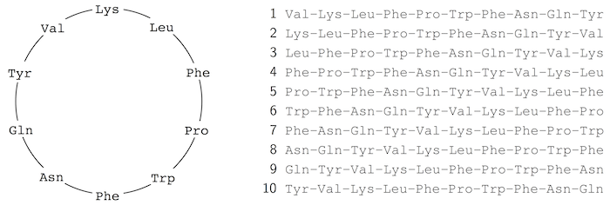
Neither Gause nor Synge was aware of it, but tyrocidines and gramicidins are actually cyclic peptides; the cyclic representation for Tyrocidine B1 is shown on the left in the figure below. Thus, Tyrocidine B1 has ten different linear representations, and we should run the Peptide Encoding Problem on every one of these sequences to find potential 30-mers coding for Tyrocidine B1. Yet when we solve the Peptide Encoding Problem for each of the ten strings on the right in the figure below, we find no 30-mer in the Bacillus brevis genome encoding Tyrocidine B1!

Slide 19
Dodging the Central Dogma of Molecular Biology

Slide 20
Hopefully, you are perplexed, because the Central Dogma of Molecular Biology implies that all peptides must be encoded by the genome. Nobel laureate Edward Tatum was just as confused, and in 1963, he devised an ingenious experiment. Protein translation is carried out by a molecular machine called a ribosome, and so Tatum reasoned that if he inhibited the ribosome, all protein production in Bacillus brevis should grind to a halt. To his amazement, all proteins did indeed shut down — except for tyrocidines and gramicidins! His experiment led Tatum to hypothesize that some yet unknown non-ribosomal mechanism must assemble these peptides.
In 1969, Fritz Lipmann (another Nobel laureate) demonstrated that tyrocidines and gramicidins are non-ribosomal peptides (NRPs), synthesized not by the ribosome, but by a giant protein called NRP synthetase. This enzyme pieces together antibiotic peptides without any reliance on RNA or the genetic code! We now know that every NRP synthetase assembles peptides by growing them one amino acid at a time, as shown in the figure below.

Slide 21
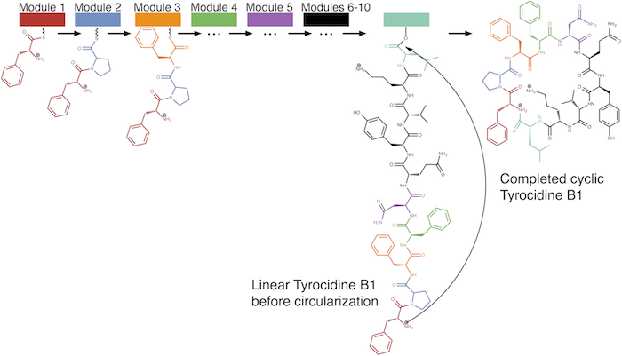
NRP synthetase is a giant multi-module protein that assembles a cyclic peptide in steps, one amino acid at a time. Each of ten different modules (shown by different colors) adds a single amino acid to the peptide, which in the figure is one of many tyrocidines produced by Bacilus brevis. In a final step, the peptide is circularized.
NRPS

Slide 22
Sequencing Antibiotics By Shattering Them Into Pieces

Slide 23
Introduction to mass spectrometry
Since NRPs do not adhere to the Central Dogma, we cannot infer them from the genome, which brings us back to where we started. What makes sequencing these peptides even more difficult is that many NRPs (including tyrocidines and gramicidins) are cyclic. Thus, the standard tools for sequencing linear peptides, which we will describe in a follow-up chapter, are not applicable to NRP analysis.

Slide 24
The workhorse of peptide sequencing is the mass spectrometer, an expensive molecular scale that shatters molecules into pieces and then weighs the resulting fragments. The mass spectrometer measures the mass of a molecule in daltons (Da); 1 Da is approximately equal to the mass of a single nuclear particle .
We will approximate the mass of a molecule by simply adding the number of protons and neutrons found in the molecule’s constituent atoms, which yields the molecule’s integer mass. For example, the amino acid glycine, which has chemical formula C2H3ON, has an integer mass of 57, since 2·12 + 3·1 + 1·16 + 1·14 = 57
Tyrocidine B1, which is represented by VKLFPWFNQY, has total mass 1322 Da
(99 + 128 + 113 + 147 + 97 + 186 + 147 + 114 + 128 + 163 = 1322).

Slide 25
Mass spectrometer performance
The mass spectrometer can break each molecule of Tyrocidine B1 into two linear fragments, and it analyzes samples that may contain billions of identical copies of the peptide, with each copy breaking in its own way. One copy may break into LFP and WFNQYVK (with respective masses 357 and 965), whereas another may break into PWFN and QYVKLF. Our goal is to use the masses of these and other fragments to sequence the peptide. The collection of all the fragment masses generated by the mass spectrometer is called an experimental spectrum.

Slide 26
How can we use the experimental spectrum to sequence a peptide?
For now, we will assume for simplicity that the mass spectrometer breaks the copies of a cyclic peptide at every possible two bonds, so that the resulting experimental spectrum contains the masses of all possible linear fragments of the peptide, which are called subpeptides. For example, the cyclic peptide NQEL has 12 subpeptides: N, Q, E, L, NQ, QE, EL, LN, NQE, QEL, ELN, and LNQ.

Slide 27
The theoretical spectrum of a cyclic peptide Peptide, denoted Cyclospectrum(Peptide), is the collection of all of the masses of its subpeptides, in addition to the mass 0 and the mass of the entire peptide, with masses ordered from smallest to largest. We will assume that the theoretical spectrum can contain duplicate elements, as is the case for NQEL (shown below), where NQ and EL have the same mass.

Slide 28
algorithms

Slide 29
A Brute Force Algorithm for Cyclopeptide Sequencing
Let’s design a straightforward brute force algorithm for the Cyclopeptide Sequencing Problem. We denote the total mass of an amino acid string Peptide as Mass(Peptide). In mass spectrometry experiments, whereas the peptide that generated Spectrum is unknown, Mass(Peptide) can be inferred from ﻿Spectrum and is denoted ParentMass(Spectrum). For the sake of simplicity, we will assume that for all experimental spectra, ParentMass(Spectrum) is equal to the largest mass in Spectrum.

Slide 30
The brute force cyclopeptide sequencing algorithm
BFCyclopeptideSequencing generates all possible peptides whose mass is equal to ParentMass(Spectrum) and then checks which of these peptides has theoretical spectra matching Spectrum.
BFCyclopeptideSequencing(Spectrum)
for every peptide with Mass(Peptide) equal to ParentMass(Spectrum)
if Spectrum = Cyclospectrum(Peptide)
output Peptide

Slide 31
Counting Peptides with Given Mass Problem: Compute the number of peptides of given mass.
Input: An integer m.
Output: The number of linear peptides having integer mass m.

Slide 32
Branch-and-Bound Algorithm for Cyclopeptide Sequencing
Instead of checking all cyclic peptides with a given mass, our new approach to solving the Cyclopeptide Sequencing Problem will "grow" candidate linear peptides whose theoretical spectra are “consistent” with the experimental spectrum.
while CandidatePeptides is nonempty
CandidatePeptides ← Expand(CandidatePeptides)
for each peptide Peptide in CandidatePeptides
if Mass(Peptide) = ParentMass(Spectrum)
if Cyclospectrum(Peptide) = Spectrum and Peptide is not in FinalPeptides
append Peptide to FinalPeptides
remove Peptide from CandidatePeptides
else if Peptide is not consistent with Spectrum
remove Peptide from CandidatePeptides
return FinalPeptides

Slide 33
Mass Spectrometry Meets Golf
Although CyclopeptideSequencing successfully reconstructed Tyrocidine B1, this algorithm only works in the case of an ideal spectrum, i.e., when the experimental spectrum of a peptide coincides exactly with its theoretical spectrum. This inflexibility of CyclopeptideSequencing presents a practical barrier, since mass spectrometers generate "noisy" spectra that are far from ideal — they are characterized by having both false masses and missing masses. A false mass is present in the experimental spectrum but absent from the theoretical spectrum; a missing mass is present in the theoretical spectrum but absent from the experimental spectrum.

Slide 34
To generalize the Cyclopeptide Sequencing Problem to handle noisy spectra, we need to relax the requirement that a candidate peptide’s theoretical spectrum must match the experimental spectrum exactly, and instead incorporate a scoring function that will select the peptide whose theoretical spectrum matches the given experimental spectrum the most closely. Given a cyclic peptide Peptide and a spectrum Spectrum, we define Score(Peptide, Spectrum) as the number of masses shared between Cyclospectrum(Peptide) and Spectrum. Recall our previous example:

Slide 35
Cyclopeptide Scoring Problem: Compute the score of a cyclic peptide against a spectrum.
Input: An amino acid string Peptide and a collection of integers Spectrum.
Output: The score of Peptide against Spectrum, Score(Peptide, Spectrum).
Cyclopeptide Sequencing Problem (for spectra with errors): Find a cyclic peptide having maximum score against an experimental spectrum.
Input: A collection of integers Spectrum.
Output: A cyclic peptide Peptide maximizing Score(Peptide, Spectrum) over all peptides Peptide with mass equal to ParentMass(Spectrum).

Slide 36
LeaderboardCyclopeptideSequencing.
LeaderboardCyclopeptideSequencing(Spectrum, N)
Leaderboard ← set containing only the empty peptide
LeaderPeptide ← empty peptide while Leaderboard is non-empty
Leaderboard ← Expand(Leaderboard) for each Peptide in Leaderboard if Mass(Peptide) = ParentMass(Spectrum) if Score(Peptide, Spectrum) > Score(LeaderPeptide, Spectrum)
LeaderPeptide ← Peptide else if Mass(Peptide) > ParentMass(Spectrum) remove Peptide from Leaderboard
Leaderboard ← Trim(Leaderboard, Spectrum, N) output LeaderPeptide

Slide 37
From 20 to More than 100 Amino Acids
Until now, we have assumed that just 20 amino acids form the building blocks of proteins; these building blocks are called proteinogenic amino acids. There are actually two additional proteinogenic amino acids, called selenocysteine and pyrrolysine, which are incorporated into proteins by special biosynthetic mechanisms .
Yet in addition to the 22 proteinogenic amino acids, NRPs contain non-proteinogenic amino acids, which expand the number of possible building blocks for antibiotic peptides from 20 to over 100.
Enlarging the amino acid alphabet spells trouble for our current approach to cyclopeptide sequencing. Indeed, the correct peptide now must “compete” with many more incorrect ones for a place on the leaderboard, increasing the chance that the correct peptide will be cut along the way.
For example, although Tyrocidine B1 contains only proteinogenic amino acids, its close relative, Tyrocidine B (Val-Orn-Leu-Phe-Pro-Trp-Phe-Asn-Gln-Tyr), contains a non-proteinogenic amino acid called ornithine (Orn). Because so many non-proteinogenic amino acids exist, bioinformaticians often assume that any integer between 57 and 200 may represent the mass of an amino acid; the “lightest” amino acid, glycine (Gly), has mass 57 Da, and most amino acids have masses smaller than 200 Da.

Slide 38
The Spectral Convolution Saves the Day
composition of a peptide from its experimental spectrum would be to take the smallest masses present in the spectrum (between 57 and 200 Da). However, even if only a single amino acid mass is missing, then this approach will fail to reconstruct the peptide's amino acid composition.
Let’s take a different approach. Say that our experimental spectrum contains the masses of subpeptides NQE and NQ. If we subtract these two masses, then we will obtain the mass E for free, even if it was not present in the experimental spectrum! If the underlying peptide is NQEL, then we can also find the mass of E by subtracting the masses of QE and Q or NQEL and LNQ.

Slide 39
Following this example, we define the convolution of a spectrum by taking all positive differences of masses in the spectrum. The tables on the next steps show the convolutions of the theoretical and simulated spectra of NQEL that we encountered before (spectra reproduced below).

Slide 40
From Simulated to Real Spectra
the mass spectrometer first converts subpeptides into ions Ionization of particles helps the mass spectrometer sort the ions by using an electromagnetic field; ions are separated not by their mass, but rather according to their mass/charge ratio. If fragment ion NQY (integer mass: 114 + 128 + 163 = 405) has charge +1, then it contains one additional proton, resulting in a total integer mass of 406 and a mass/charge ratio of 406/1 = 406. To be more precise, the monoisotopic mass of NQY is approximately 114.043 + 128.058 + 163.063 = 405.164, and the mass of a proton is 1.007 Da, which makes the mass charge/ratio more closely equal to (405.164 + 1.007)/1 = 406.171.

Slide 41
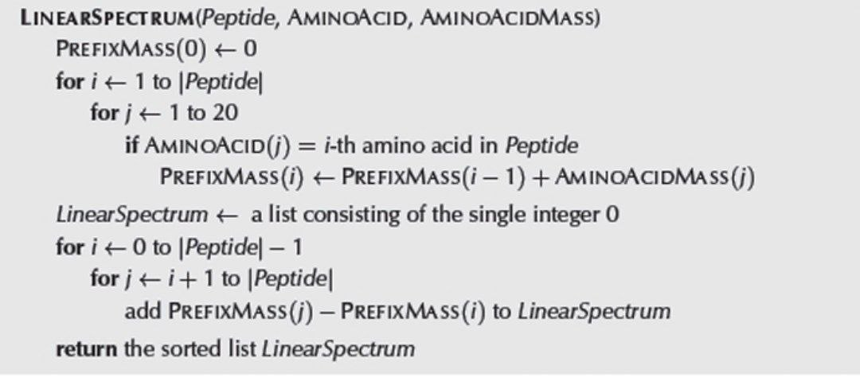

Slide 42
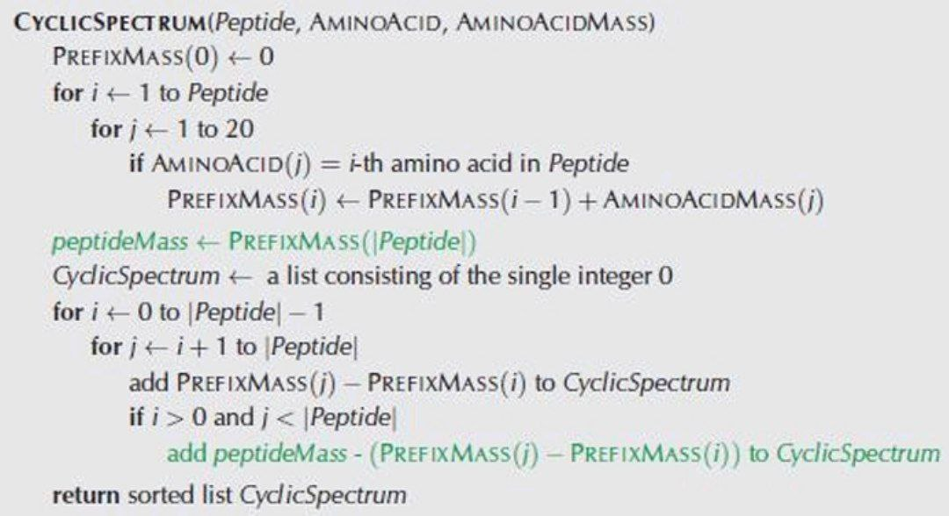

Slide 43
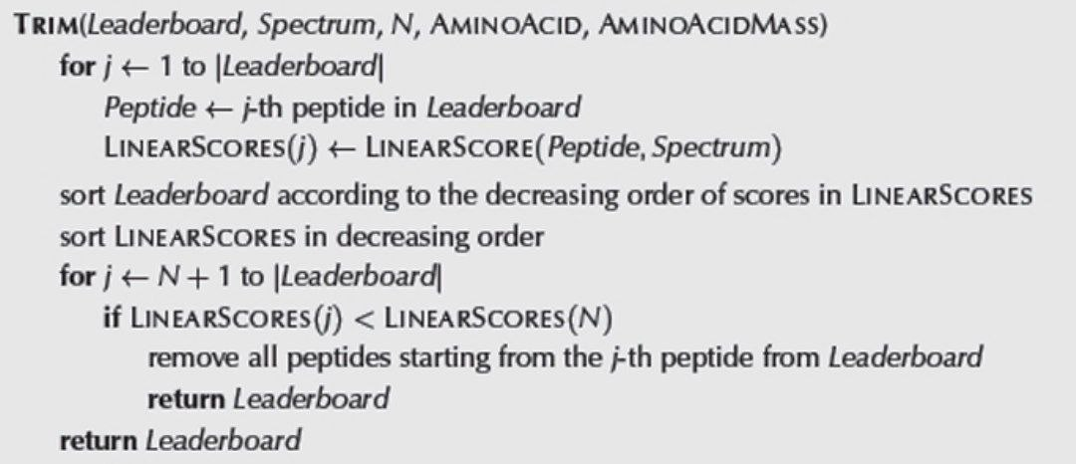

Slide 44
THANKs for YOUr patience

